Slide 1






Graph Neural Networks
Nikita Kazeev

Slide 2
Plan
The conceptual advantages of graph neural networks
Graph neural networks (GNNs)
GNNs in high energy physics
GNNs in low energy physics

Slide 3
What is the point of graphs?

Slide 4
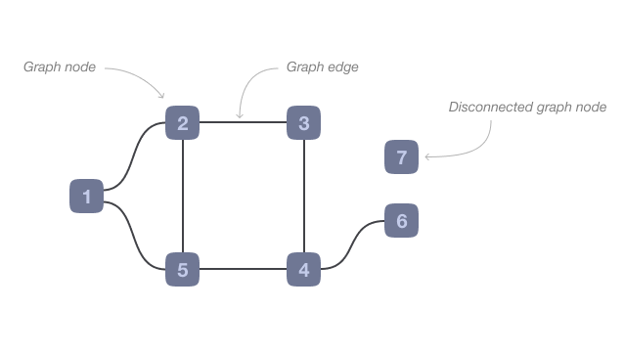
A graph

Slide 5
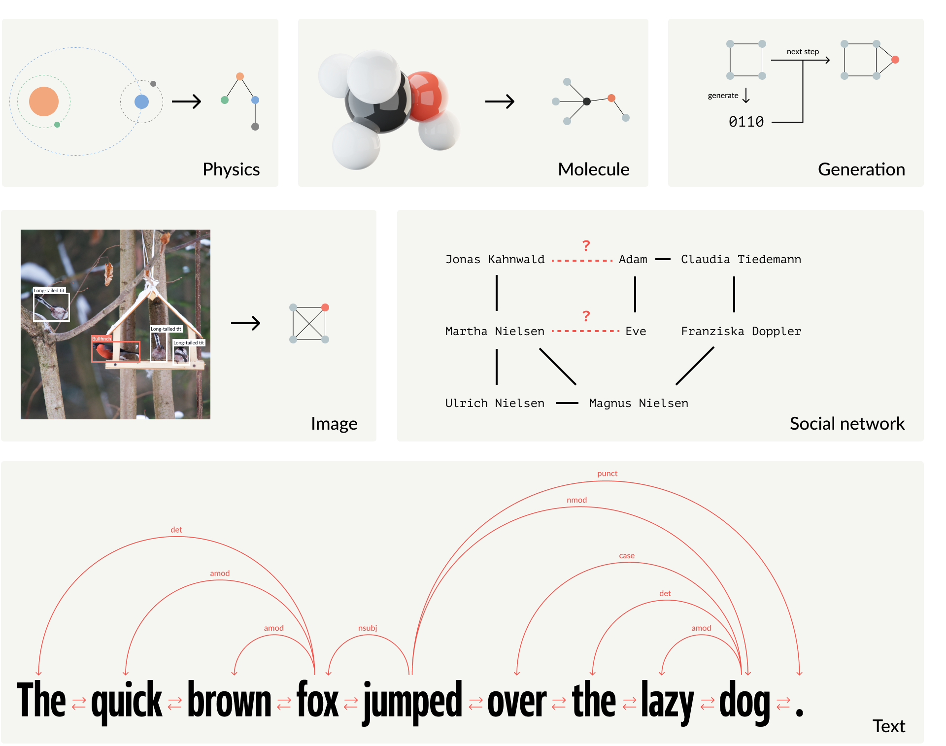
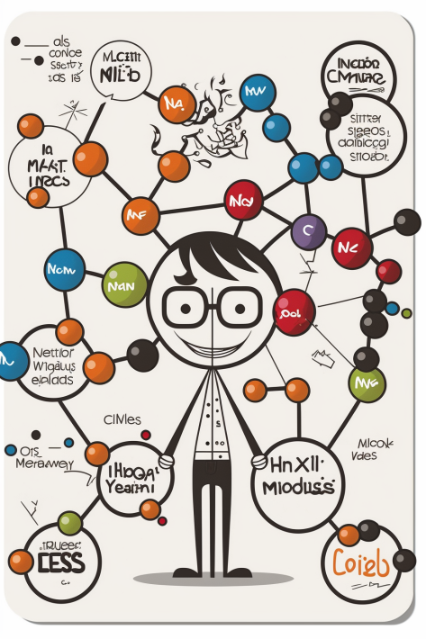
Graphs of the world
Notes:
There are naturally graph-typed data
Social networks
We are doing physics
What makes graphs an attractive representation?

Slide 6
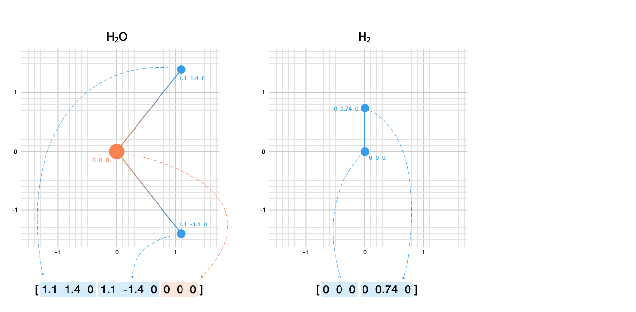

Toy (not really) problem: predict potential energy of a molecule Naïve attempt
Profit?

Slide 7
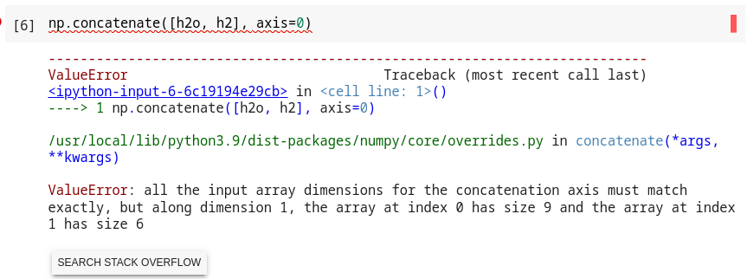
No varying system size No profit

Slide 8
No varying system size No profit
0 0 0 ]
Fine, let's pad with 0's

Slide 9
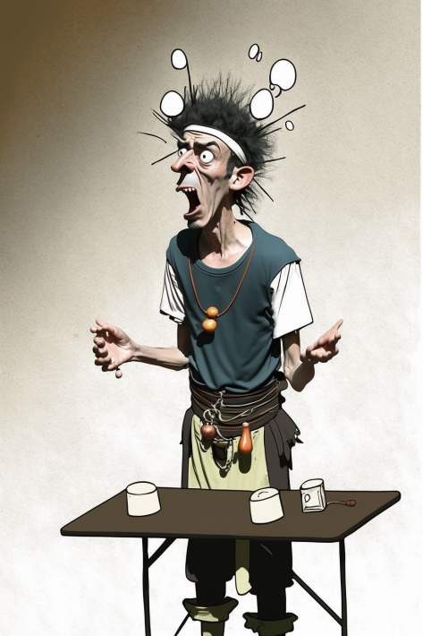
No permutation invariance No profit
Charge | x | y | z
1 | 1.1 | -1.4 | 0
1 | 1.1 | 1.4 | 0
16 | 0 | 0 | 0
= [1 1.1 -1.4 0 1 1.1 1.4 0 16 0 0 0]
Why not this?
Charge | x | y | z
1 | 1.1 | -1.4 | 0
16 | 0 | 0 | 0
1 | 1.1 | 1.4 | 0
= [1 1.1 1.4 -1.4 0 16 0 0 0 1 1.1 1.4 0]

Slide 10
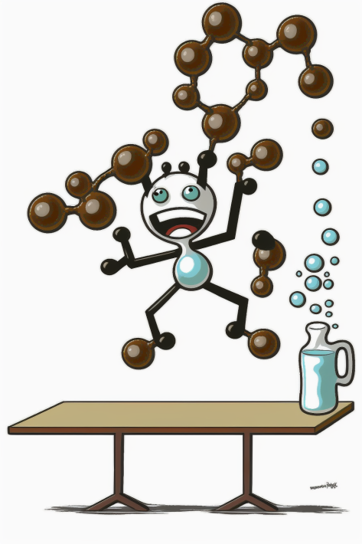
No translation invariance No profit
Charge | x | y | z
1 | 1.1 | -1.4 | 0
1 | 1.1 | 1.4 | 0
16 | 0 | 0 | 0
= [1 1.1 -1.4 0 1 1.1 1.4 0 16 0 0 0]
Why not this?
Charge | x | y | z
1 | 2.1 | -1.4 | 0
1 | 2.1 | 1.4 | 0
16 | 1 | 0 | 0
= [1 2.1 -1.4 0 1 2.1 1.4 0 16 1 0 0]

Slide 11
Toy (not really) problem: predict potential energy of a molecule Naïve attempt
Augment with random permutations
Augment with random rotations and translations
Zero-padding up to maximum molecule size
Given enough data, this might work,
but incredibly data-inefficient
[1 1.4 -1.4 0 1 1.1 1.4 0 16 0 0 0 0 0 0 0
0 0 0 0 0 0 0 0 0 0 0 0 0 0 0 ]

Slide 12
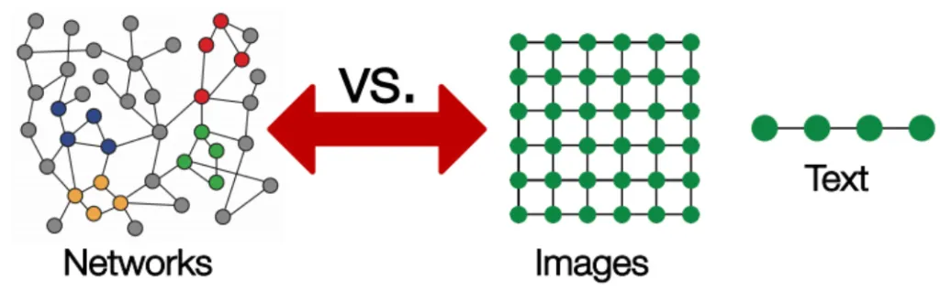
Graph as a representation Easy to construct, but hard to machine learn
In machine learning inductive bias is everything
Graphs provide:
Permutation invariance
Different system size
Locality of interactions
Source

Slide 13
Graph Neural Network (GNN)

Slide 14
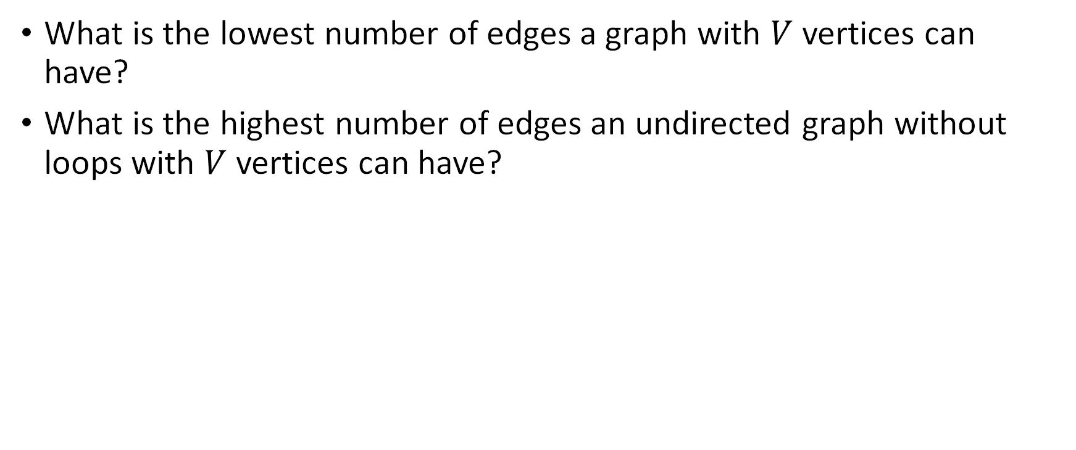
Quizz
What is the lowest number of edges a graph with $V$ vertices can have?
What is the highest number of edges an undirected graph without loops with $V$ vertices can have?

Slide 15
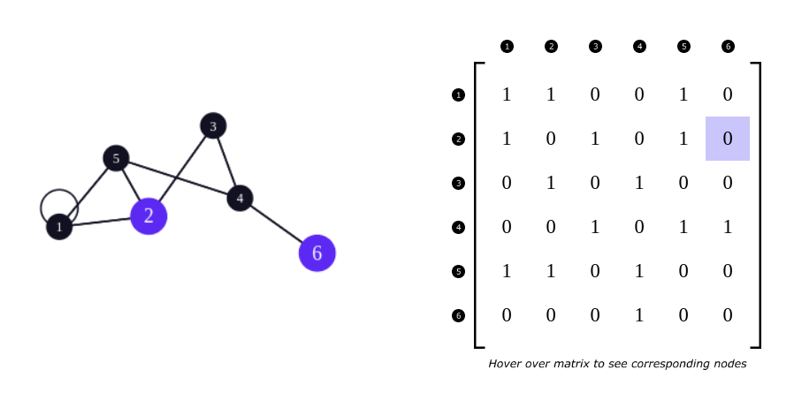
Adjacency matrix

Slide 16
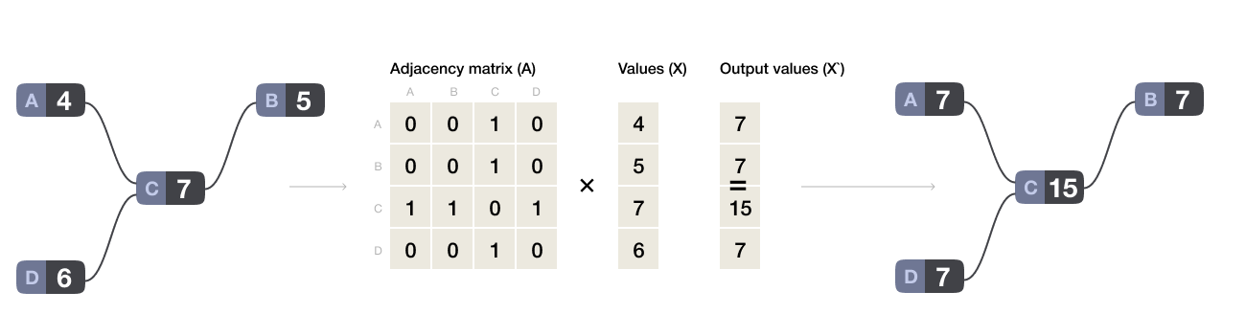
Sum over neighbors as matrix operations

Slide 17
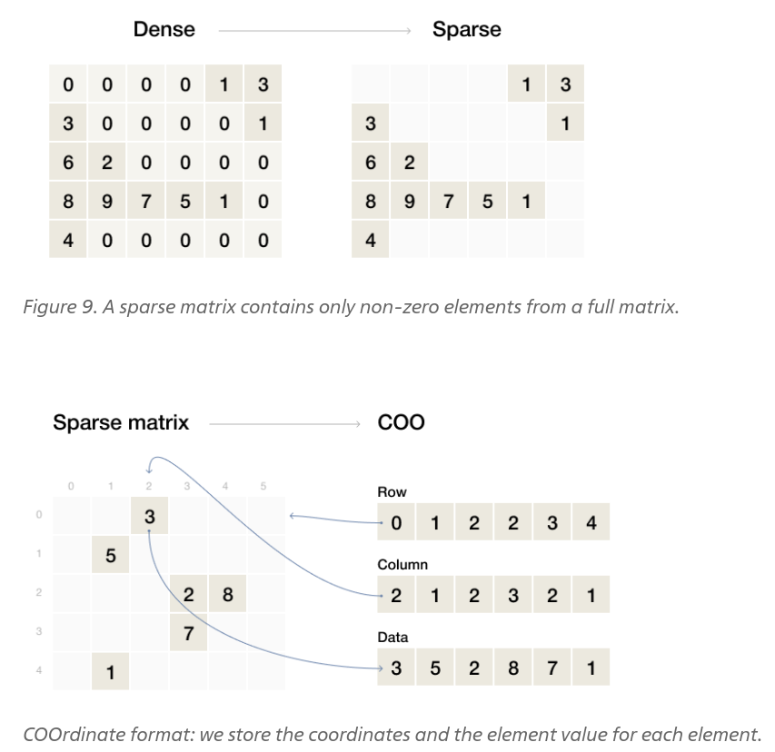
Meet sparse matrices

Slide 18
Graph convolution

Slide 19
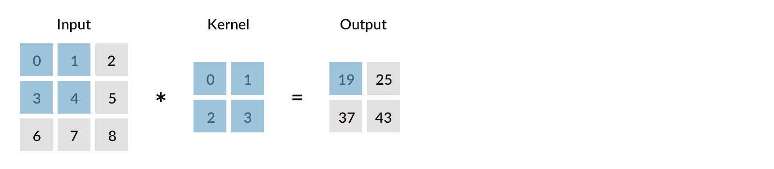
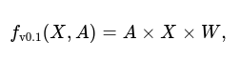
From image to graph convolution
Naive graph convolution. Not the final GCNN!

Slide 20
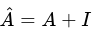
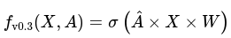
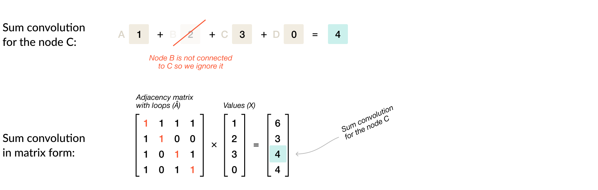
Aspecta!
We didn't include information about the features of the node itself
Non-linearity, e. g. ReLu

Slide 21
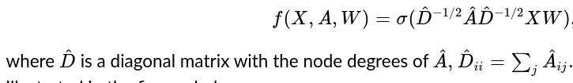
Last touch: normalization

Slide 22
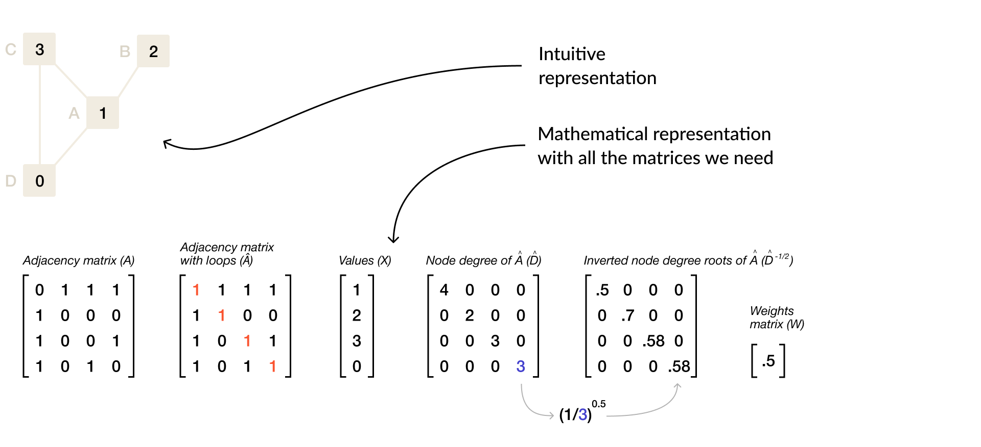
Example: stage 0

Slide 23
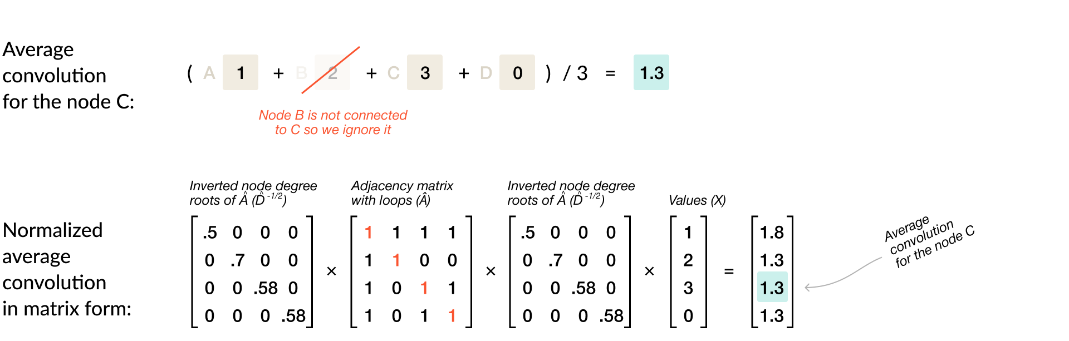
Example: stage 2

Slide 24
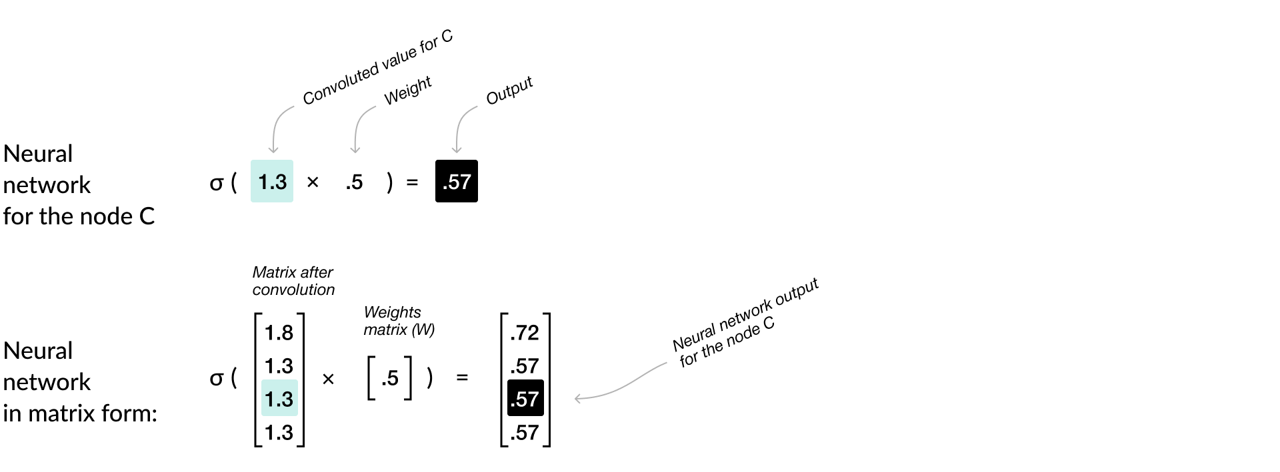
Example: stage 3

Slide 25
Graph convolution: summary
Similar to convolution in images
One layer averages the values among the neighbouring nodes
With trainable weights and non-linearity, can be combined into a deep neural network

Slide 26
General GNN

Slide 27
GraphNN at a glance
Input: graph, each edge and node has a state vector; global state vector
Output: graph; global state vector
Doesn't change connectivity
Steps:
Compute new edge states
Compute new node states
Compute new global state

Slide 28
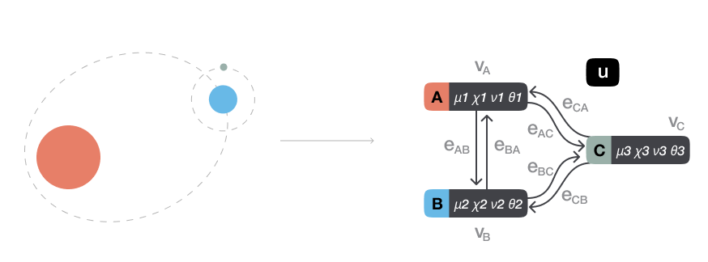
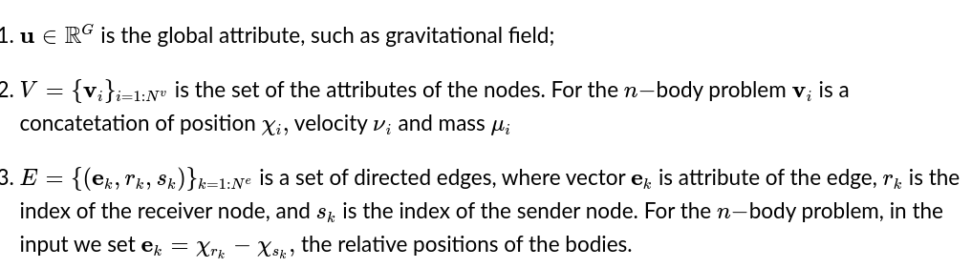
Example system and definitions

Slide 29
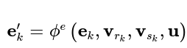
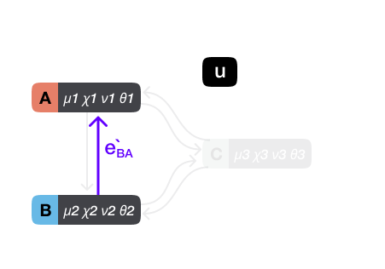
Edges update
MLP

Slide 30
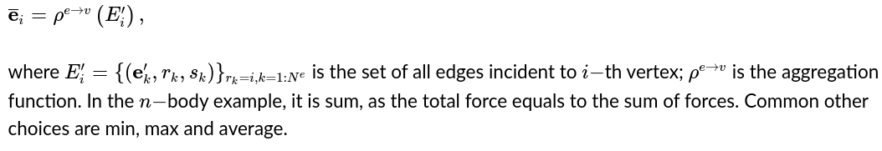
Aggregation of the edges' states

Slide 31
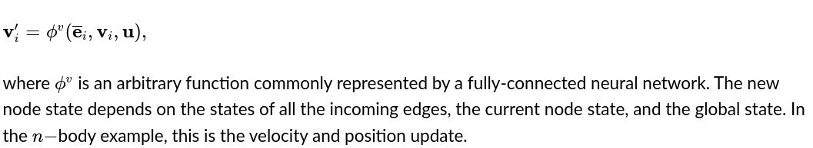
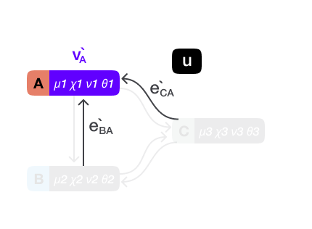
Node update

Slide 32
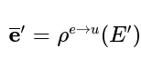
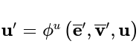
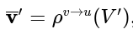
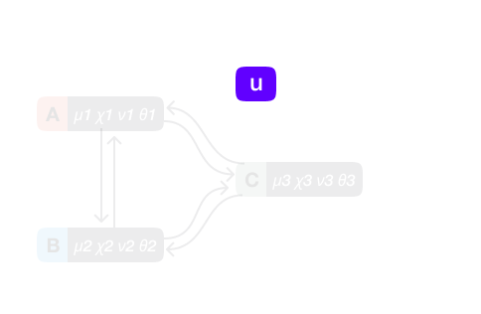
Aggregation of states of all the edges and nodes and global state update

Slide 33
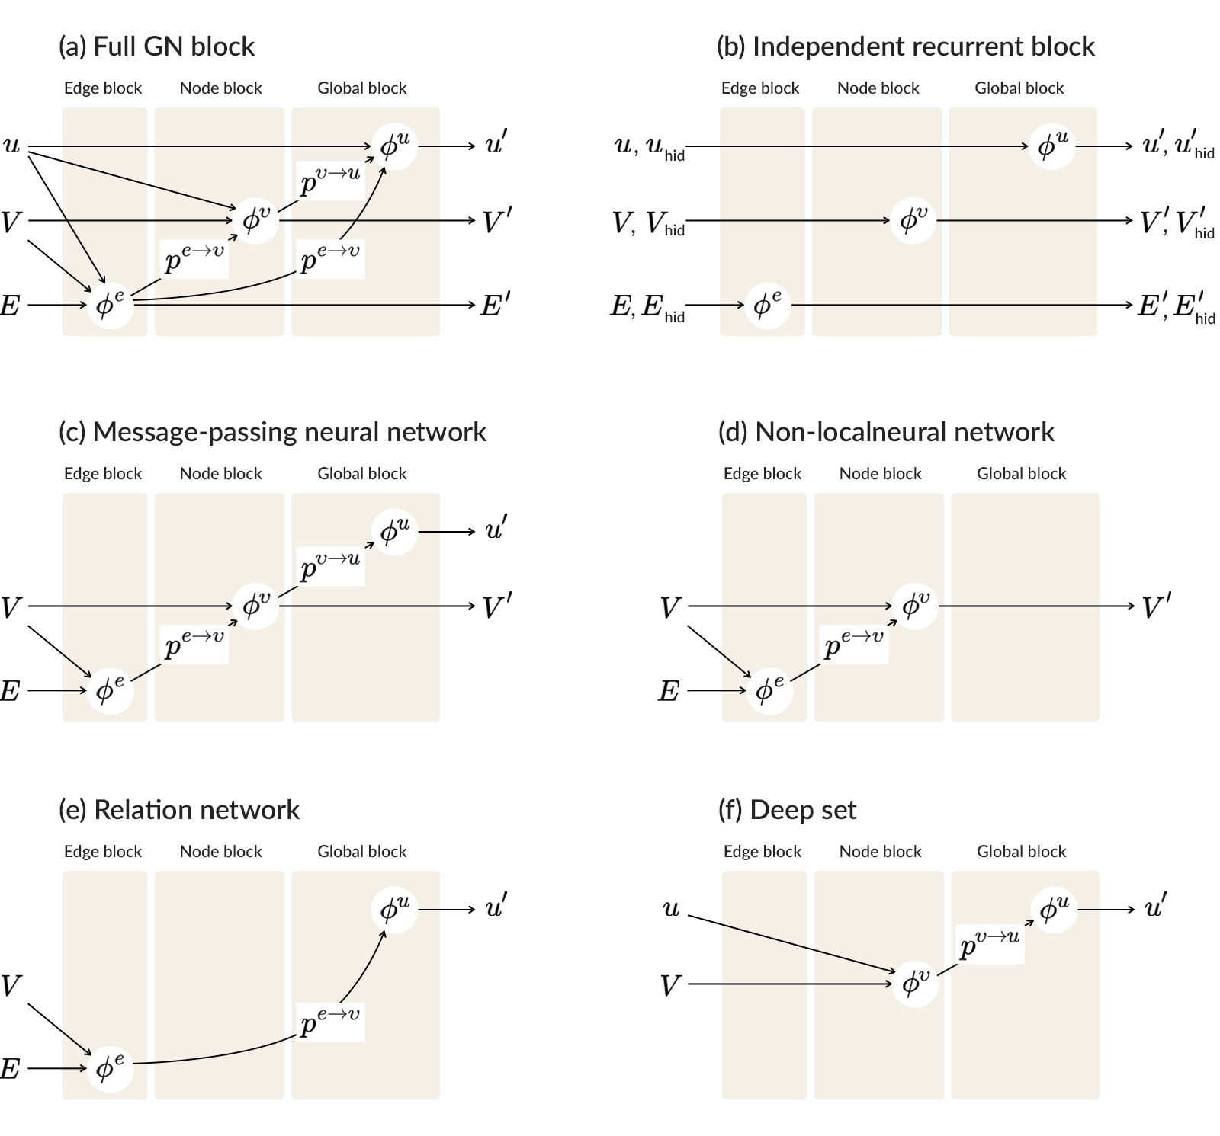
GNN block summary

Slide 34
GNN kinds

Slide 35
Deep GraphNN
Input has the same structure as output, stack layers to make it deep
Can mark any of the states as the output
Trainable via back-propagation
Suitable for predicting global, node and edge targets

Slide 36
Graph neural networks in HEP

Slide 37
Jet tagging
Moreno, Eric A., et al. "JEDI-net: a jet identification algorithm based on interaction networks." The European Physical Journal C 80 (2020): 1-15.

Slide 38
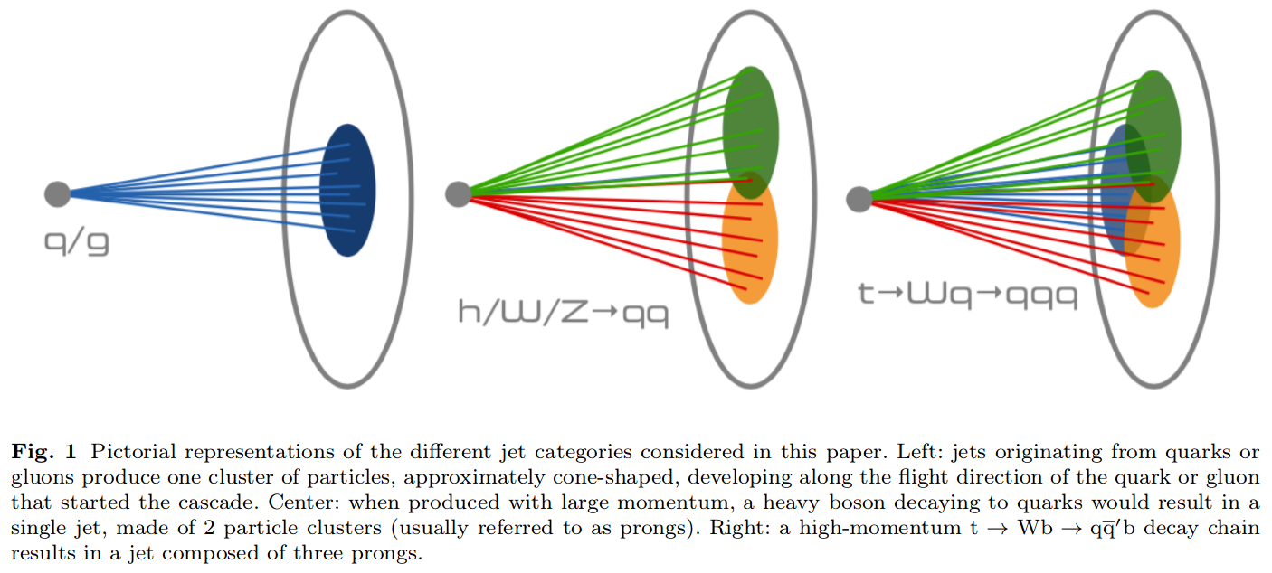
Physics

Slide 39
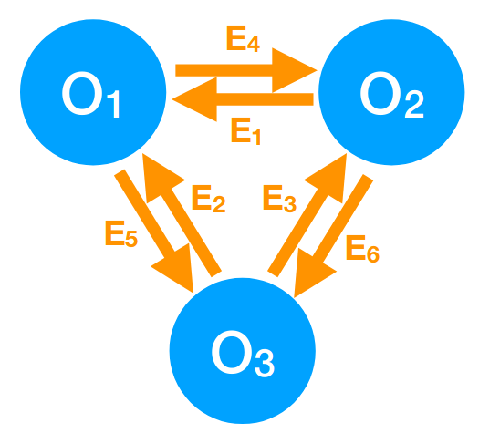
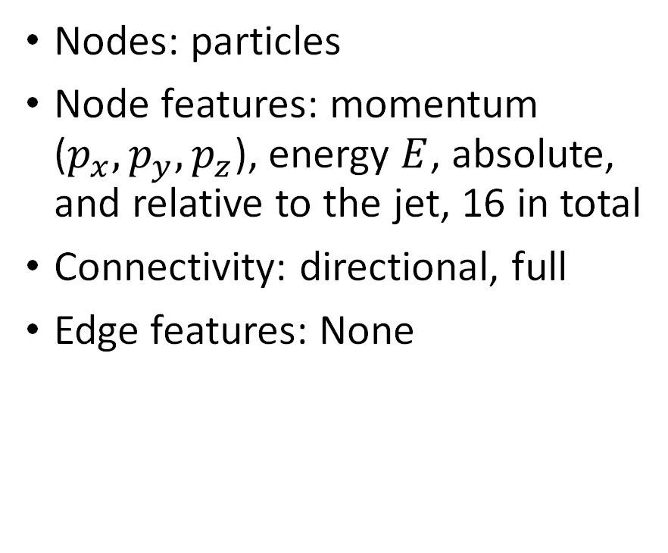
Graph construction
Nodes: particles
Node features: momentum ($p_{x},p_{y},p_{z}$), energy $E$, absolute, and relative to the jet, 16 in total
Connectivity: directional, full
Edge features: None

Slide 40
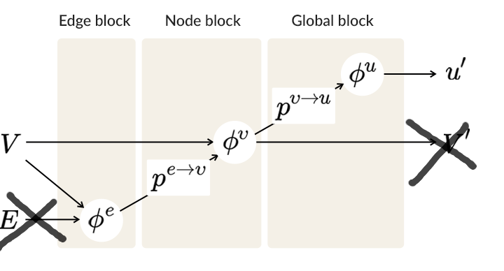
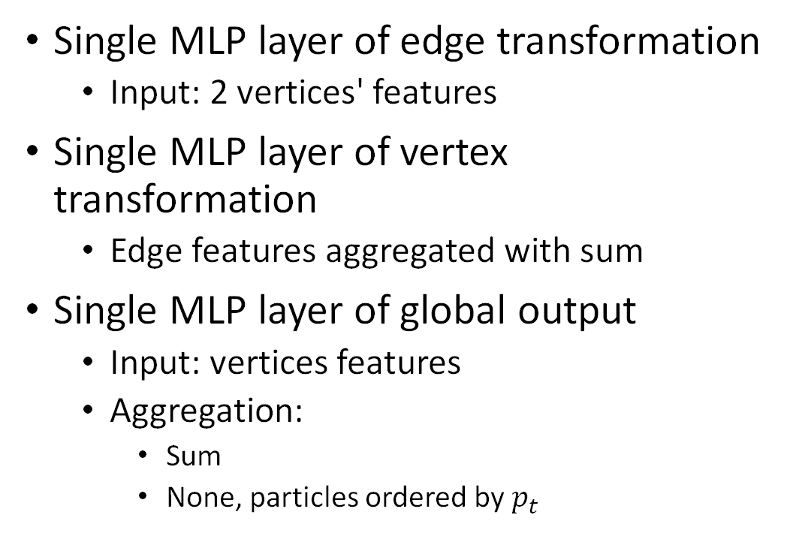
GNN
Single MLP layer of edge transformation
Input: 2 vertices' features
Single MLP layer of vertex transformation
Edge features aggregated with sum
Single MLP layer of global output
Input: vertices features
Aggregation:
Sum
None, particles ordered by $p_{t}$
Almost message-passing GNN

Slide 41
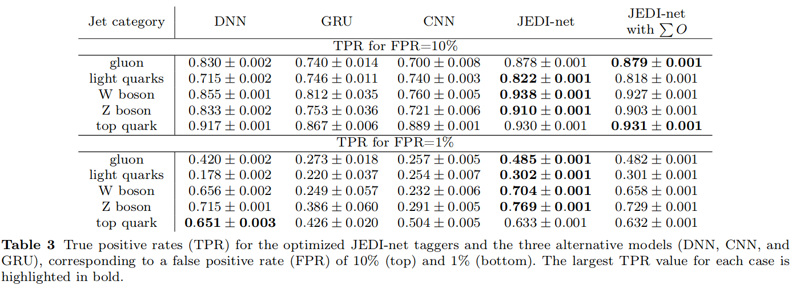
Results

Slide 42
Jet tagging: advanced
Gong, Shiqi, et al. "An efficient Lorentz equivariant graph neural network for jet tagging." Journal of High Energy Physics 2022.7 (2022): 1-22.

Slide 43
Physics
The jet tagging result should not depend on the spatial orientation or the Lorentz boost of a jet.

Slide 44
Data
G. Kasieczka, T. Plehn and M. Russel, Top quark tagging reference dataset (2019)
Simulated
ATLAS detector
1.2M training entries, 400k validation entries, and 400k testing entries
entries represents a single jet whose origin is either an energetic top quark, a light quark, or a gluon
Quark-gluon tagging
Simulated
No detector simulation
1.6M/200K/200K for training, validation, and testing.
Z(→ νν) + (u, d, s) and Z(→ νν) + g

Slide 45
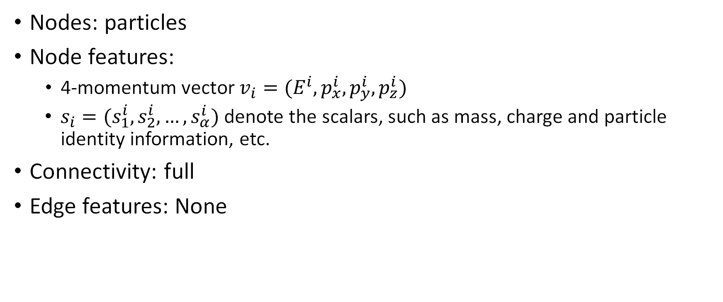
Graph construction
Nodes: particles
Node features:
4-momentum vector $v_{i}=(E^{i},p_{x}^{i},p_{y}^{i},p_{z}^{i})$
$s_{i}=(s_{1}^{i},s_{2}^{i},…,s_{α}^{i})$ denote the scalars, such as mass, charge and particle identity information, etc.
Connectivity: full
Edge features: None

Slide 46
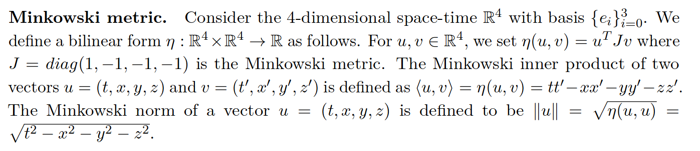
Recap: Minkowski metric

Slide 47
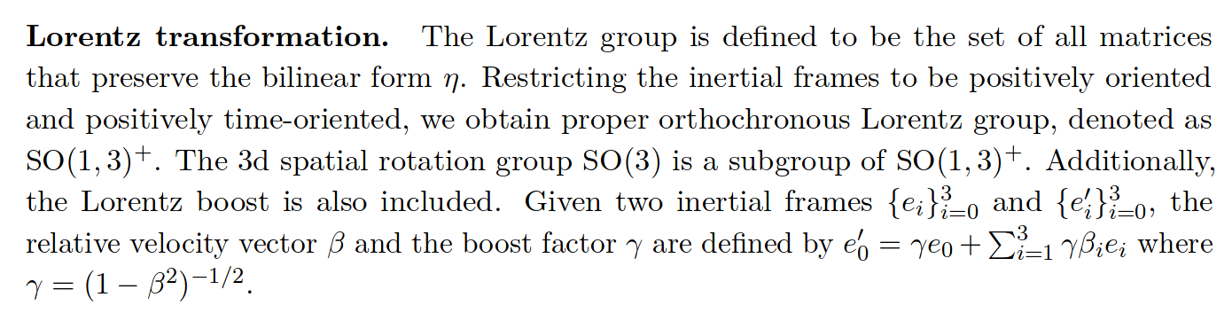
Recap: Lorenz group

Slide 48
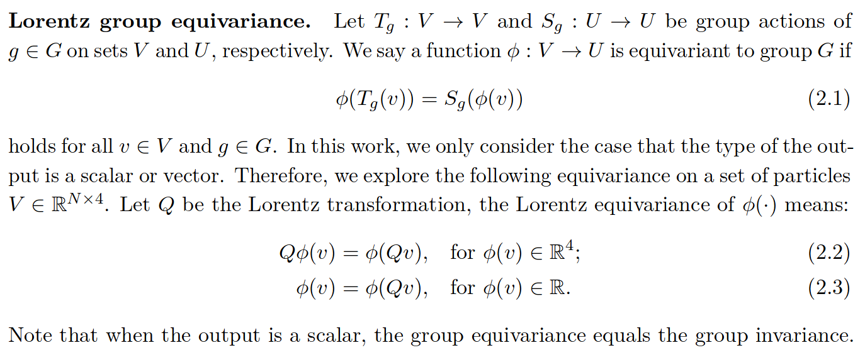
Recap: Lorentz group equivariance

Slide 49
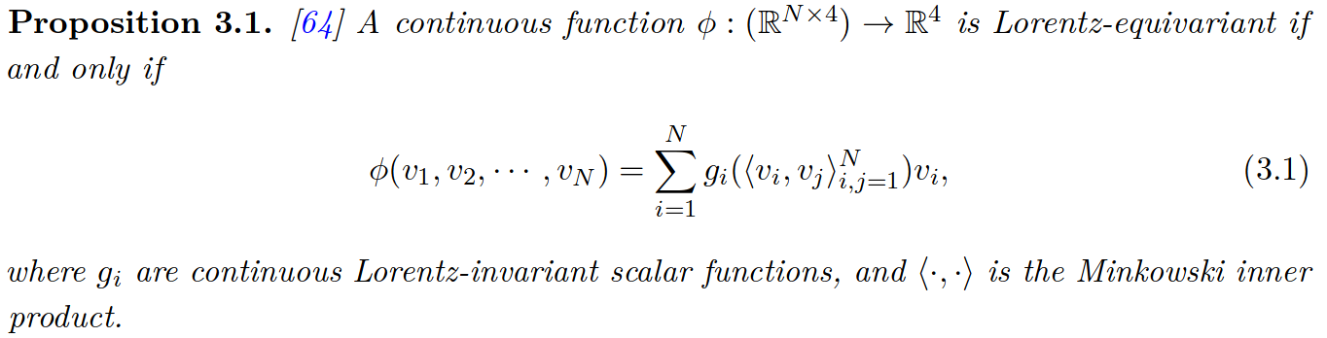
The core idea

Slide 50
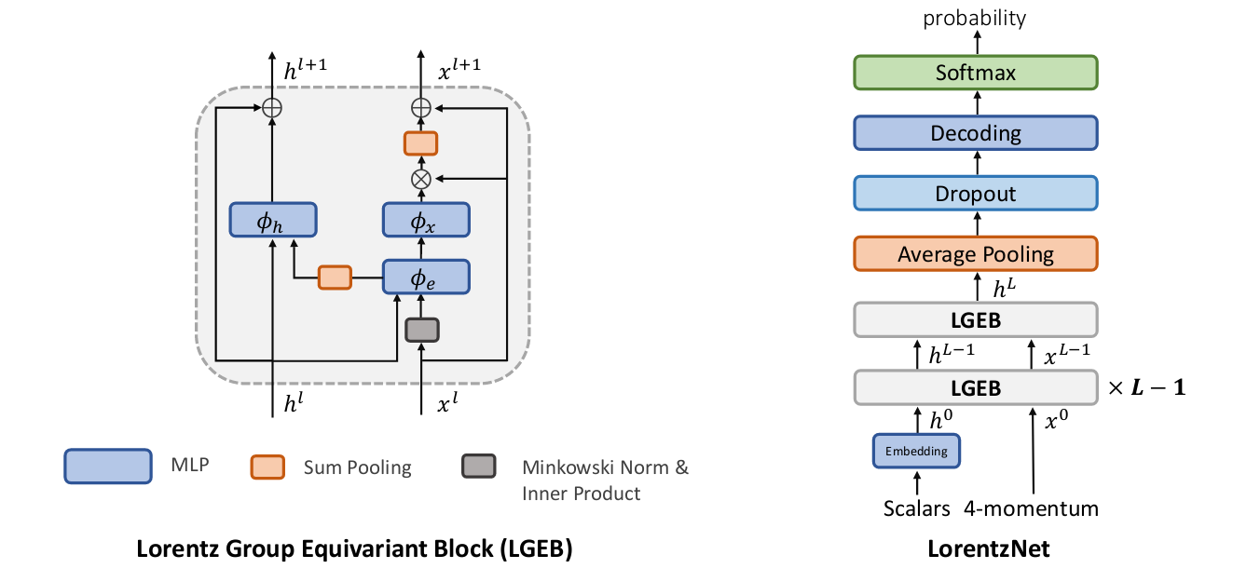
GNN

Slide 51
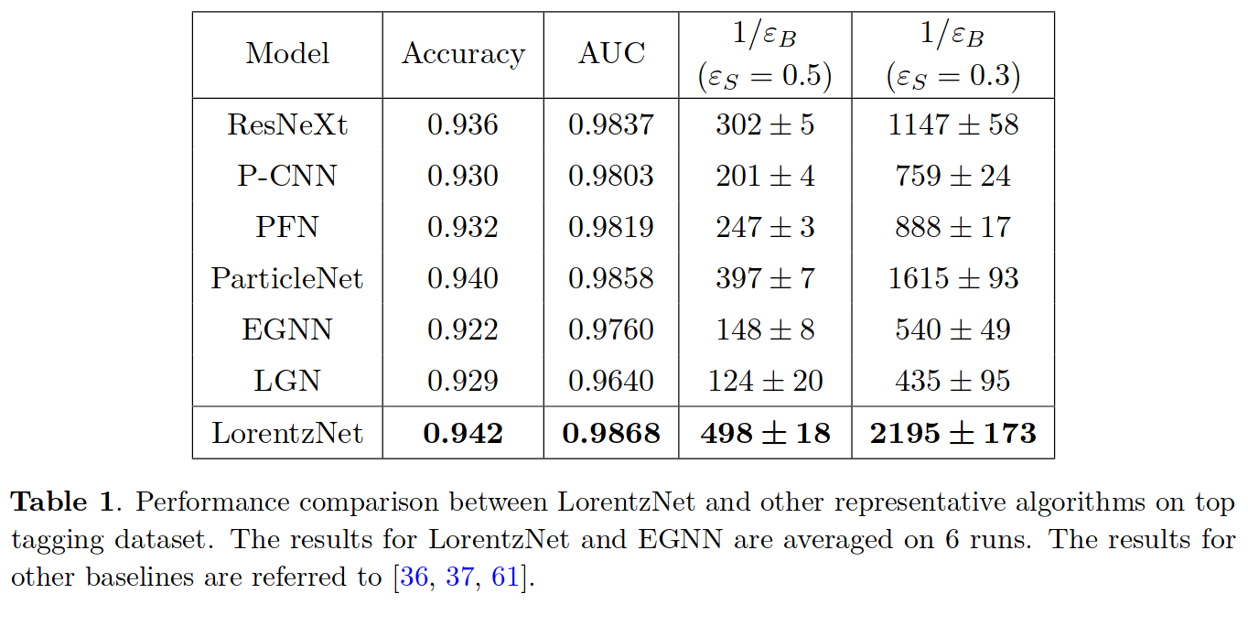
Results: top tagging

Slide 52
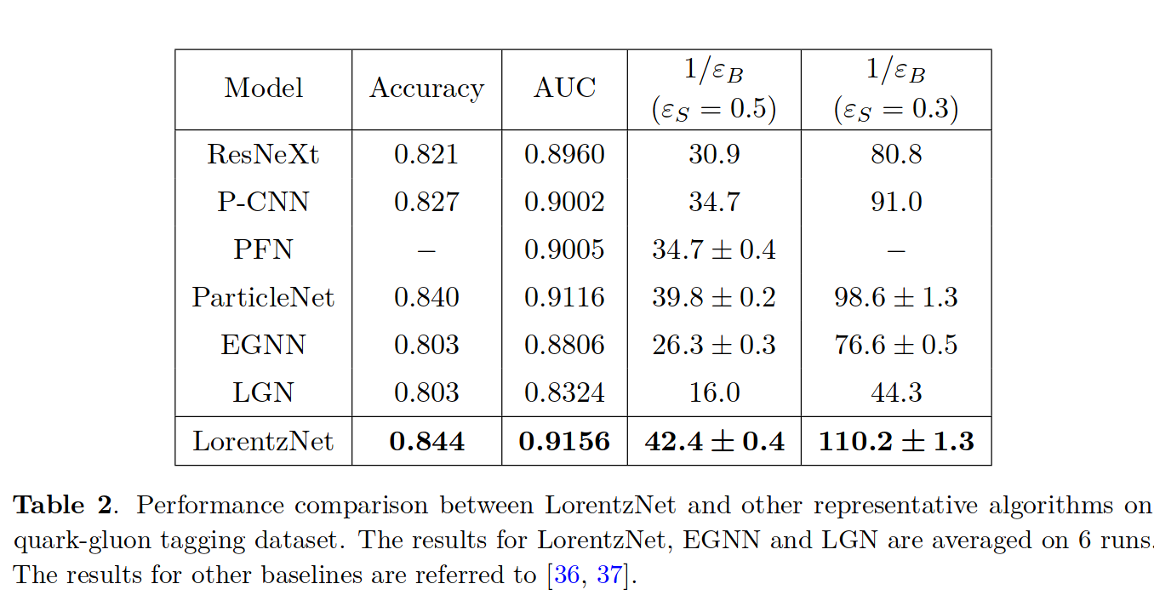
Results: quark-gluon tagging

Slide 53
Reconstructing particle showers in electromagnetic calorimeters in OPERA
Belavin, Vladislav, Ekaterina Trofimova, and Andrey Ustyuzhanin. "Segmentation of EM showers for neutrino experiments with deep graph neural networks." Journal of Instrumentation 16.12 (2021): P12035.

Slide 54
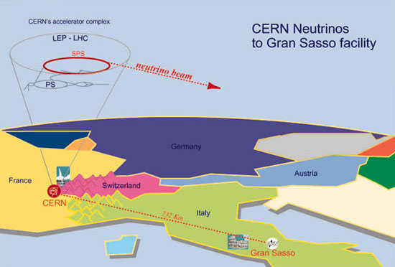
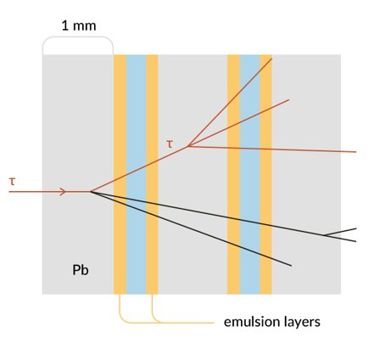
Physics
Source
Image: CERN

Slide 55
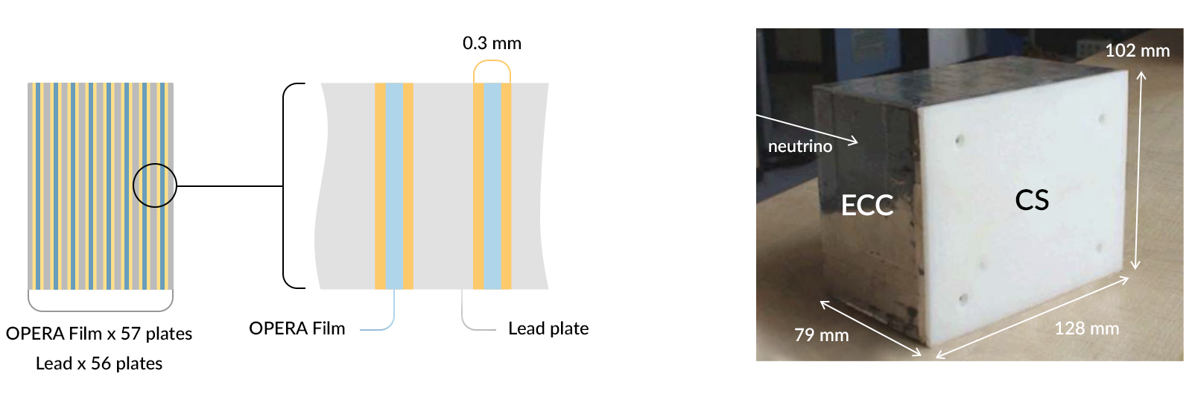
Detector
Source

Slide 56

Event
Source

Slide 57

Algorithm overview

Slide 58




Graph construction
Vertices: tracklets
Vertex features
Connections: 10 nearest neighbours, as defined by integral distance (red area in the figure)
Edge features:

Slide 59




EmulsionConv
Start with EdgeConv
$$v_{i}^{′}=\frac{\sum_{k:r_{k}=i}{e_{k}^{′}}+v_{i}}{2}$$
Problem:
Solution:
Don’t run all edge updates, and then vector updates, run them in the order of $z$
In each film, run full EdgeConv
In between the films, use the new vertex states
We need 56 EdgeConv layers to propagate through the brick

Slide 60

GNN predicting the probability that an edge connects tracklets from the same shower

Slide 61

Reconstruction
Cluster tracklets into showers using GNN predictions as distance
Using modified HDBSCAN
Predict whether the showers are well-recovered and are suitable for reconstruction
XGBoost over aggregated features
Reconstruction!
The initial particles coordinates are estimated from the median position of the first three tracklets in the cluster along the $z$ axis.
The direction is estimated by fitting a straight line to the first 20 tracklets.
The energy of the incoming particle is reconstructed with a linear regression as a function of the number of tracklets in the recovered shower.

Slide 62

Results
Energy resolution as a function of true energy. The solid line corresponds to fitted parameterized energy resolution. All variants of the proposed approach cut energy estimation uncertainty by around 50%.

Slide 63
Graph neural networks in low-energy physics
Abbasi, R., et al. "Graph Neural Networks for low-energy event classification & reconstruction in IceCube." Journal of Instrumentation 17.11 (2022): P11003.

Slide 64

Data

Slide 65


Graph construction
Nodes: observed pulses
Connectivity: 8 nearest neighbors based on the Euclidean distance
Edge features: None
Node features:
Normalized by

Slide 66

Recap: EdgeConv
concatenation
old node i features
new node j features
old node j features

Slide 67

DYNEDGE architecture
The graphs are rebuilt after each stage, connecting 8
nearest neighbors in the
latent space

Slide 68



Results
Lower is better

Slide 69
Summary
Graph neural networks
Offer a natural inductive bias for a lot of physical systems
Permutation invariance
Locality of interaction
Depending on construction, can offer more (in/eq)variances
Translation, rotation
Lorenz transformation
Variable input size
Inconvenient to code, but there are libraries

Slide 70
Learn more
A good textbook-like description
Another good textbook-like description
Battaglia, Peter W., et al. "Relational inductive biases, deep learning, and graph networks." arXiv preprint arXiv:1806.01261 (2018). - a through and math-heavy derivation and description
Zhou, Jie, et al. "Graph neural networks: A review of methods and applications." AI Open 1 (2020): 57-81.
Shlomi, Jonathan, Peter Battaglia, and Jean-Roch Vlimant. "Graph neural networks in particle physics." Machine Learning: Science and Technology 2.2 (2020): 021001.

Slide 71
Thanks, and looking forward to your questions!

Slide 72
Backup

Slide 73
HEP
Graph-level target
Jet classification (LHC)
Whole event classification (IceCube)
Node-level target
Pileup (noise) identification
Calorimeter reconstruction
Edge-level target
Charged-particle tracking
Secondary vertex reconstruction

